Slide 1

IoT
Workshop
A small introduction to the DIY spirit, electronics and programming with the Arduino Framework.
José Eduardo Ferreira da Costa
<up201907216@edu.fe.up.pt>

Slide 2
IoT Workshop
NIAEFEUP
Overview
1.
Introduction
DIY in a nutshell.
2.
Electronics
Basic components, microcontrollers and breadboards.
3.
Arduino Framework
Basics to get up and running with your own microcontroller.
4.
Hands-on
Let’s make something useful (sorta).
<número>

Slide 3
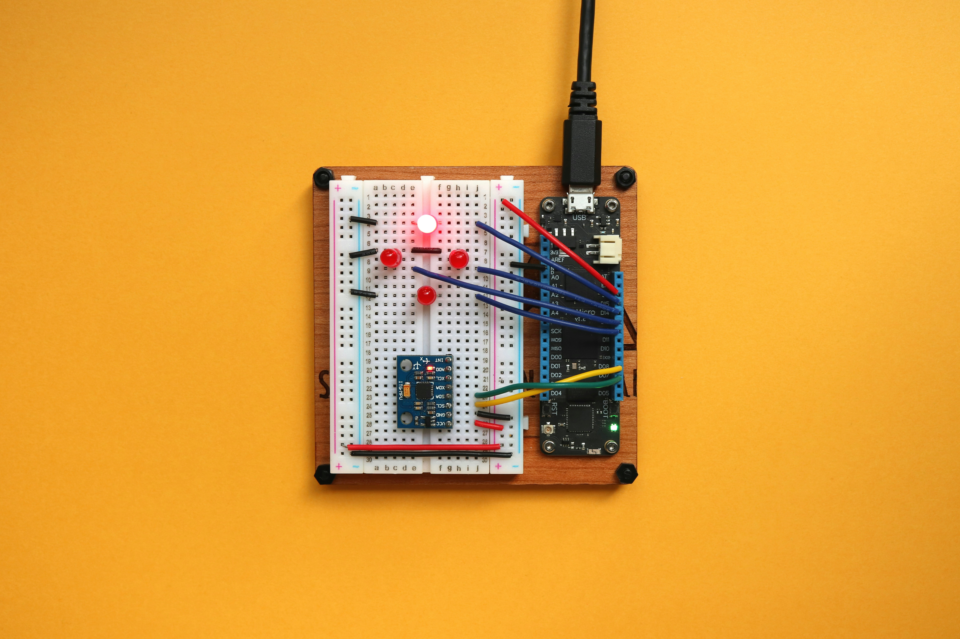
1.
Introduction
<número>

Slide 4
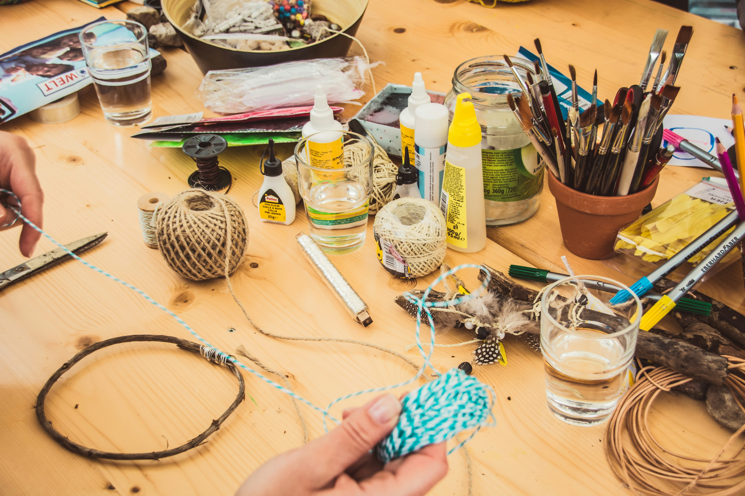
IoT Workshop
NIAEFEUP
What is DIY?
Building, modifying or repairing things without certified or professional help
Motivated by lack of funds, availability or quality, by the need for customization, etc.
Wikipedia classifies it as a means of anti-consumerism, self determination and as a cultural reaction to the pressure of academic and professional ultra specialization.
<número>

Slide 5
IoT Workshop
NIAEFEUP
What is DIY? - For me
Finding a solution for problems your on your own, using the tools you have at hand
Learning about something you never had intended to learn before
Applying this philosophy not only to electronics and software
<número>

Slide 6
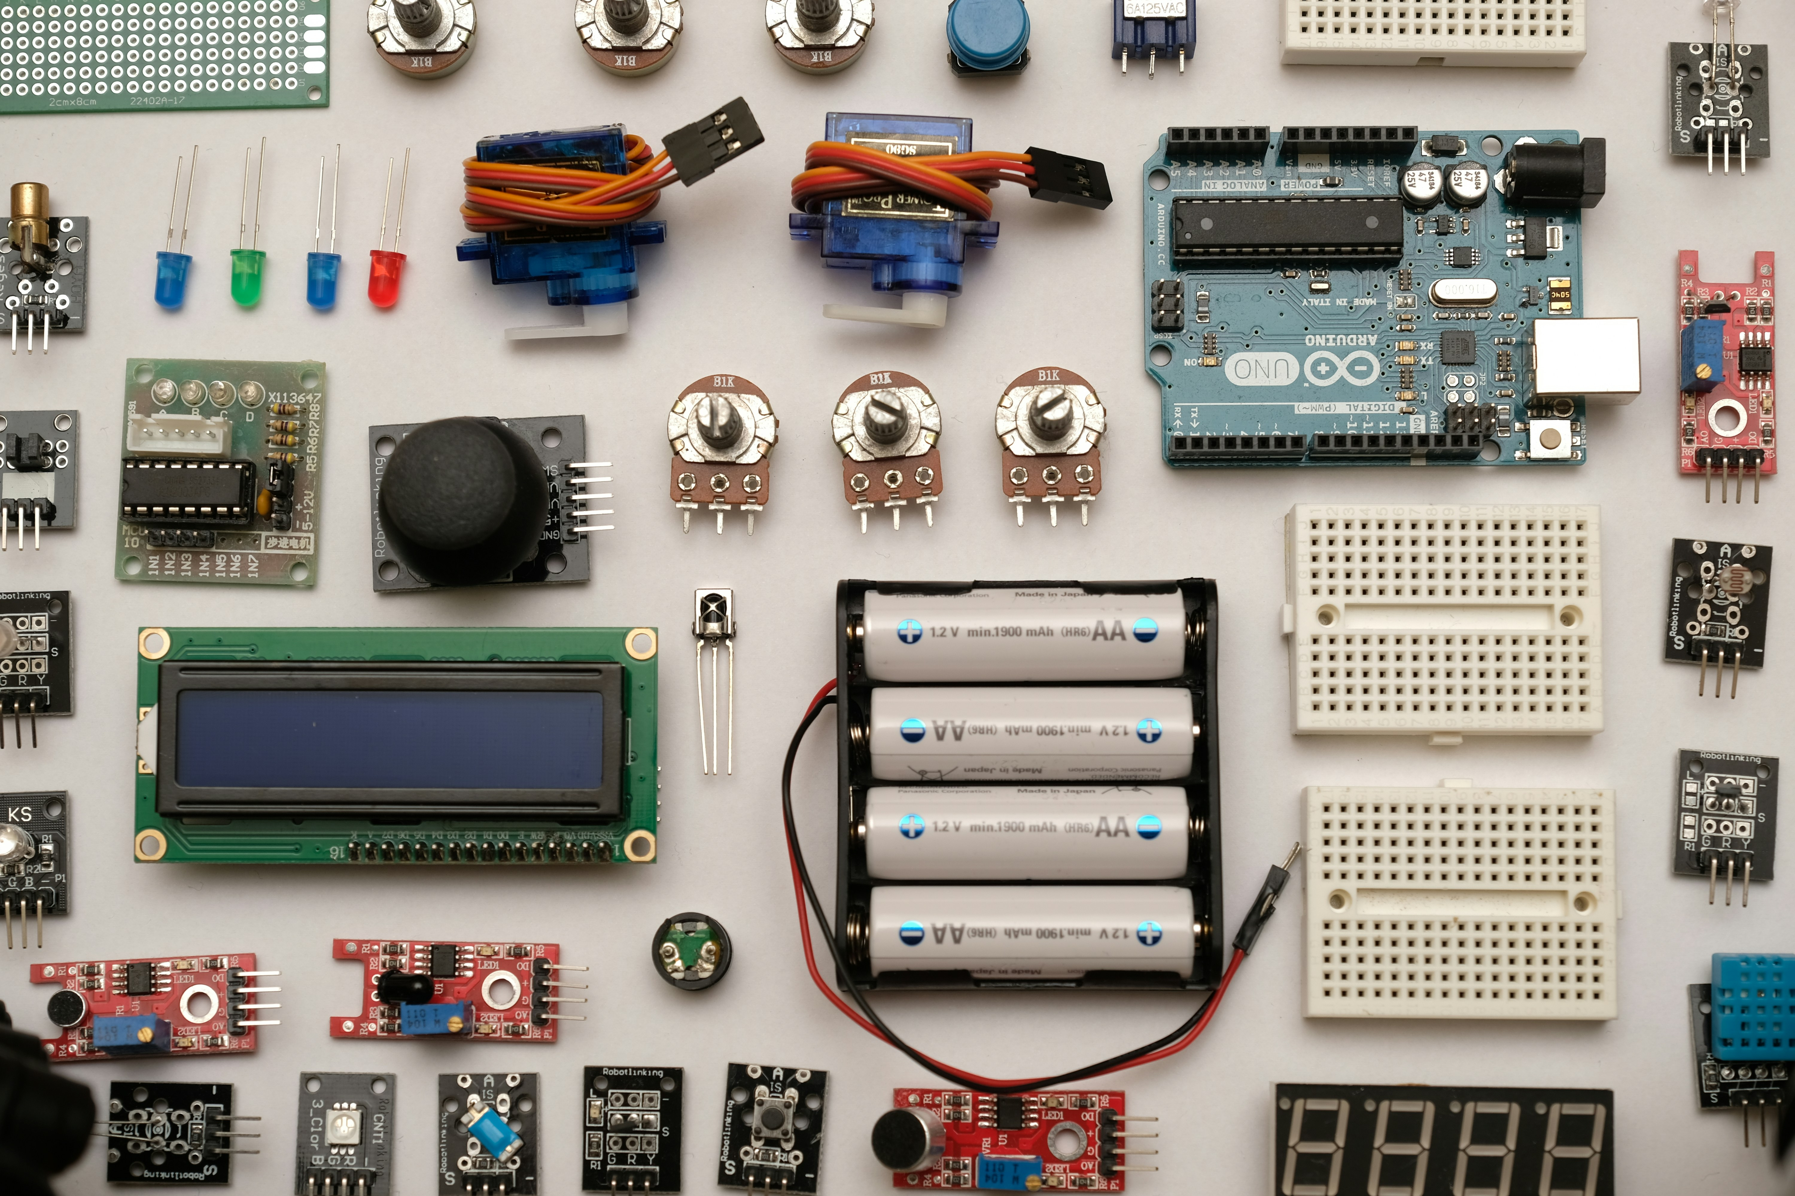
2.
Electronics
<número>

Slide 7
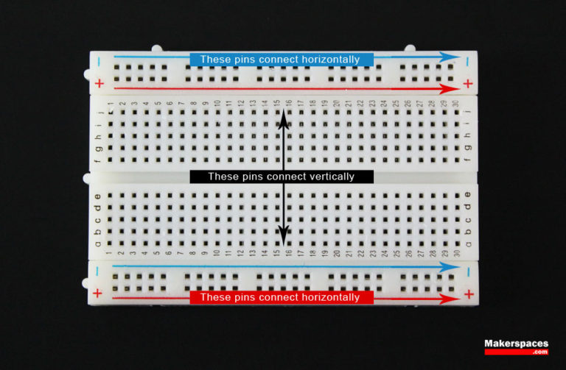
IoT Workshop
NIAEFEUP
Breadboard
Useful for prototyping circuits without the need to solder components
Power rails are connected horizontally
Other rails are connected vertically, separated by the plastic groove
<número>

Slide 8

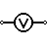
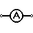
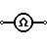
IoT Workshop
NIAEFEUP
Multimeter
Measure voltages, current, resistance and checks for continuity
Useful for troubleshooting circuits
<número>

Slide 9
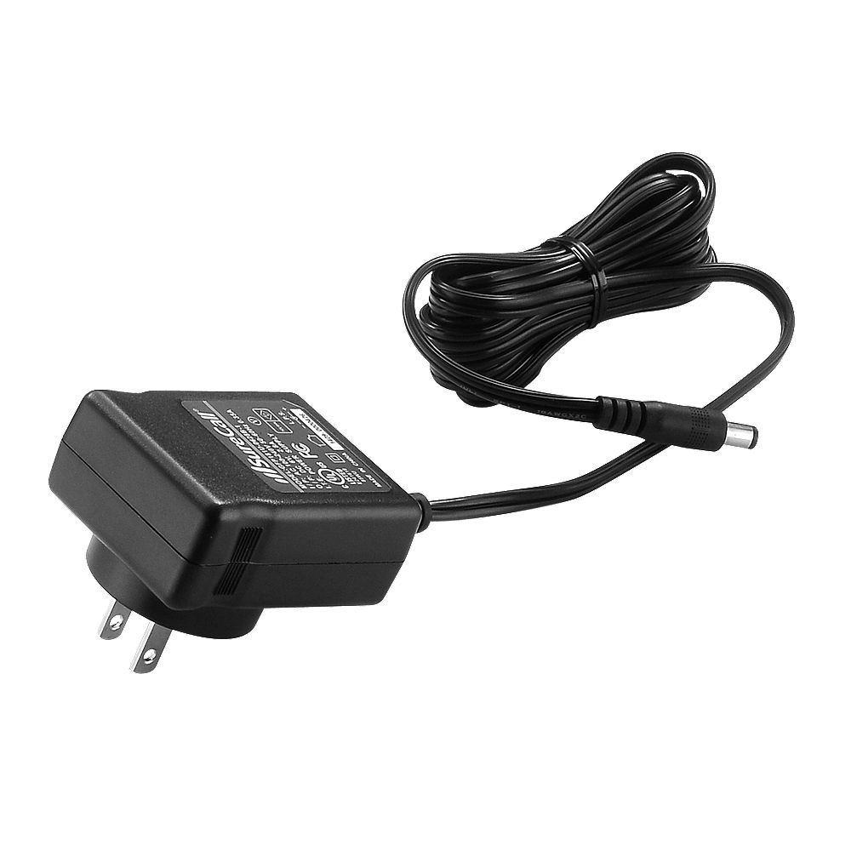
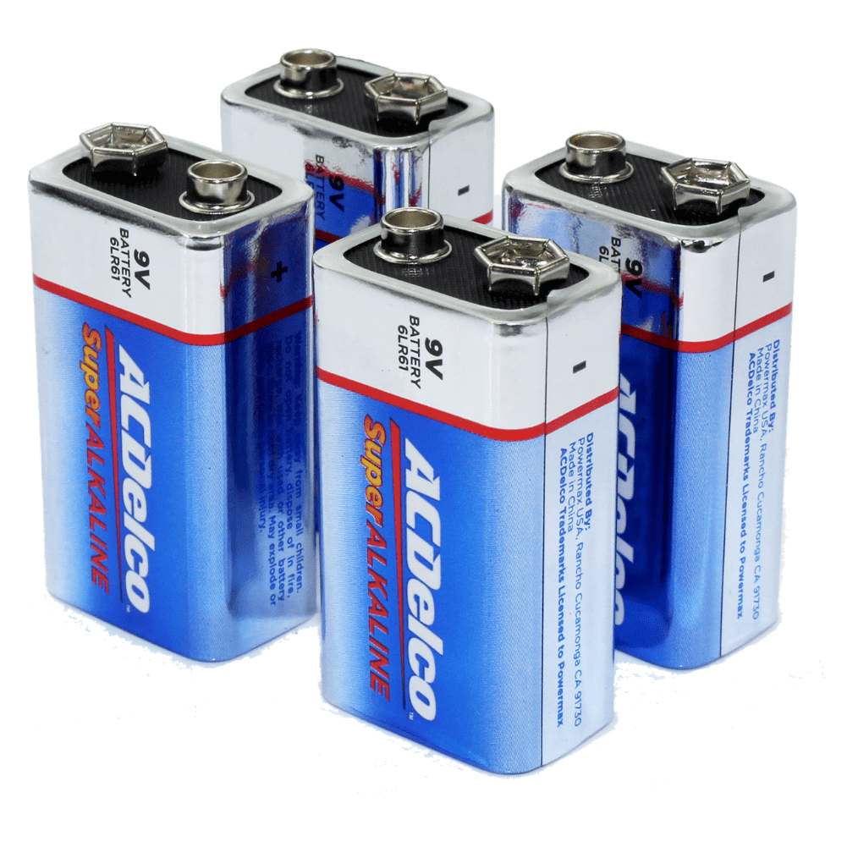
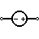
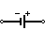
IoT Workshop
NIAEFEUP
Power supply / Batteries
Provide power to your electronics
Power supplies are characterized by their voltage (V) and current (A)
Batteries are characterized only by voltage as currents are expected to be low (250mA for a 9V, for a 2h duration)
<número>

Slide 10
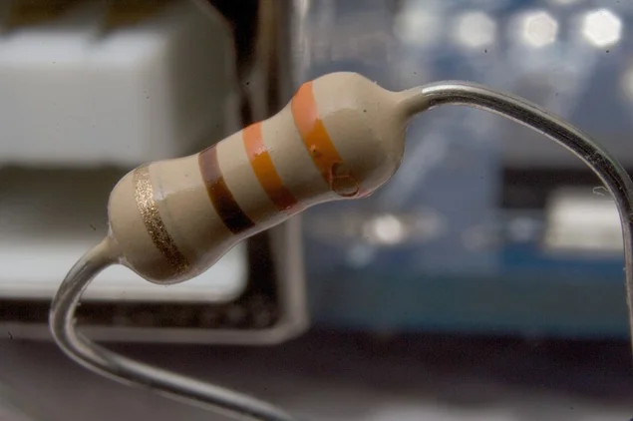
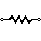
IoT Workshop
NIAEFEUP
Resistor
Used to limit currents and voltages in your circuit
Are characterized by their Impedance/Resistance (Ω, Ohm)
Also used to establish stable baselines for measurements
Carbon resistors are colour coded to represent their resistance value: Use this website to do the conversion:http://www.dannyg.com/examples/res2/resistor.htm
<número>

Slide 11
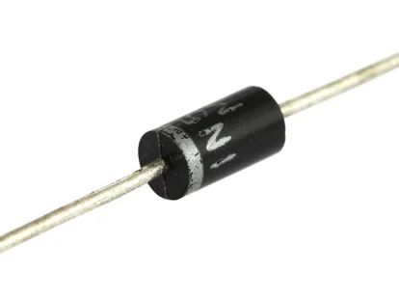
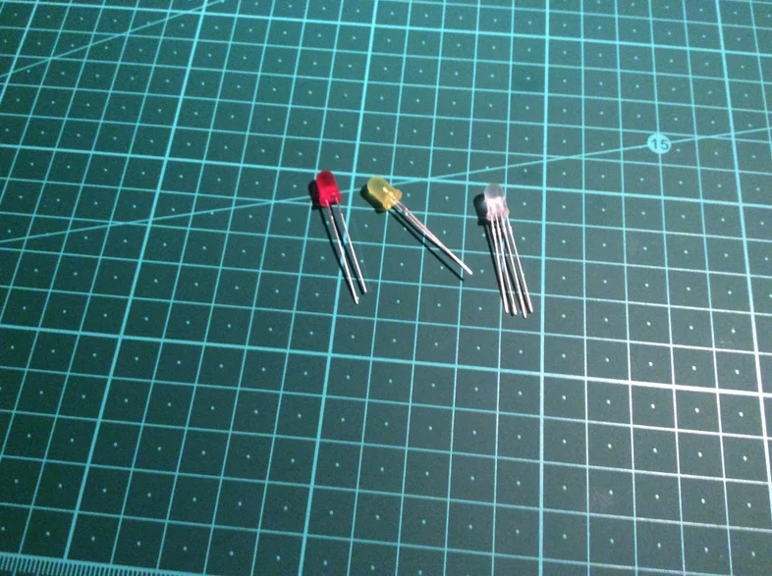
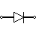
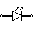
IoT Workshop
NIAEFEUP
Diode
Semiconductor device used that allows current to flow in one direction but not in the opposite direction
It has a positive (+) terminal, called cathode, and a negative (-) terminal, called anode
Several types of diodes, being the most common the light emitting diode, abbreviated to LED
<número>

Slide 12
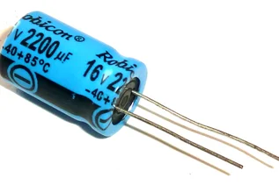
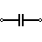
IoT Workshop
NIAEFEUP
Capacitors
Temporarily store electric charges in an electric field
Used to smooth out varying voltage DC power supplies
Unit of measurement is the Farad (F)
<número>

Slide 13
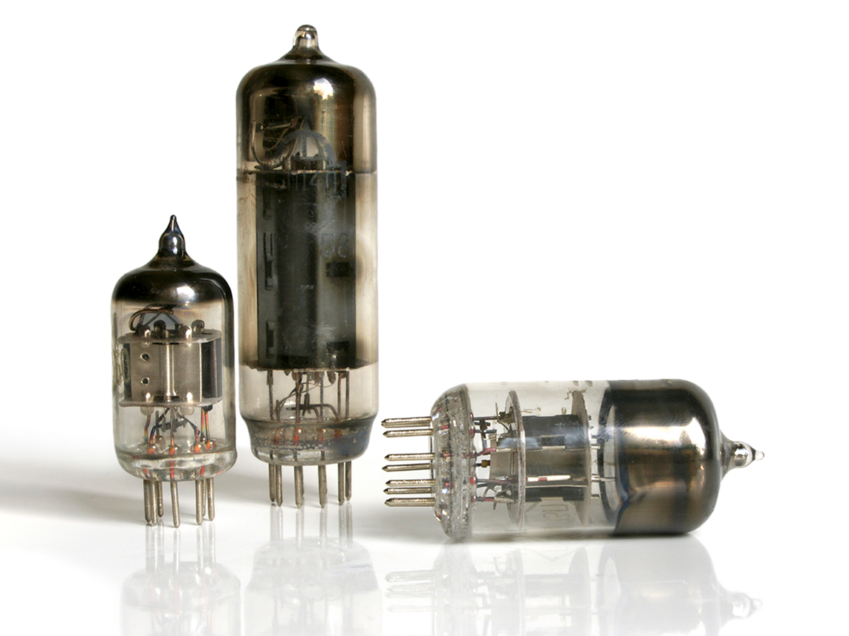
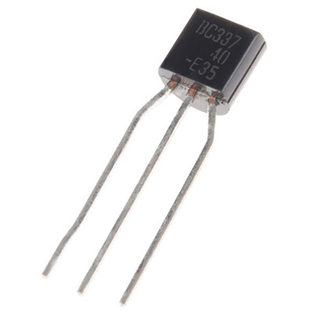
IoT Workshop
NIAEFEUP
Transistor
Semiconductor device used to switch or amplify signals and power
Voltages and currents applied in one side can control voltages and currents on the other side
Have very different types and working principles
It is considered by many one of the greatest inventions of the 20th century, allowing for the development of modern electronics, as it replaced vacuum tubes and allowed circuit miniaturization
<número>

Slide 14
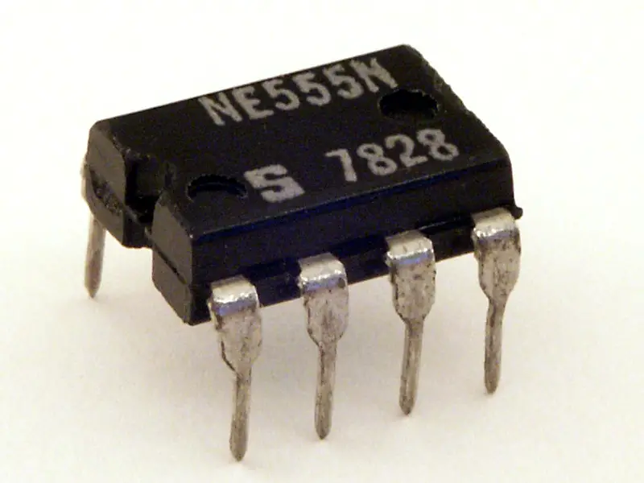
IoT Workshop
NIAEFEUP
Integrated Circuit (IC)
This is a electronic circuit using miniaturized components to implement some functionality
Each pin has a specialized function
May implement timers, voltage regulators, microcontrollers and many other components
The 555 timer
<número>

Slide 15
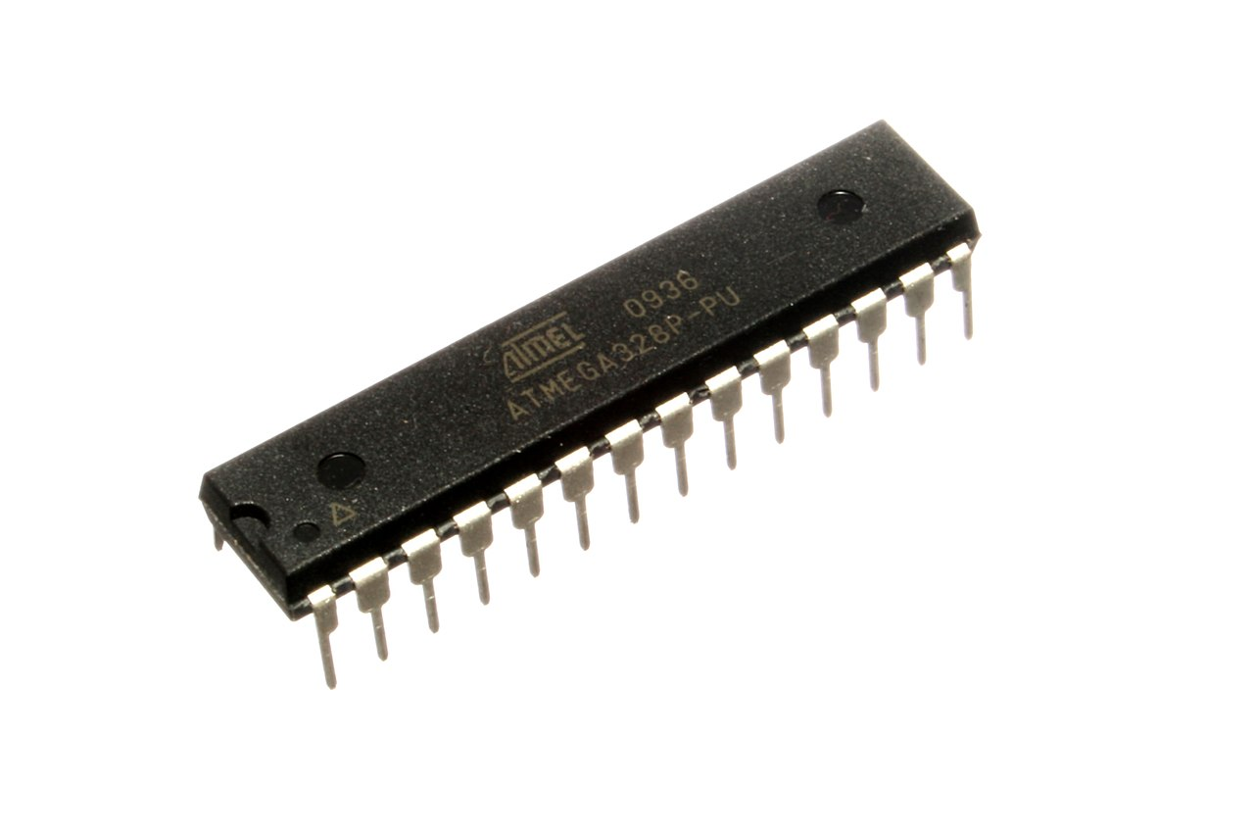
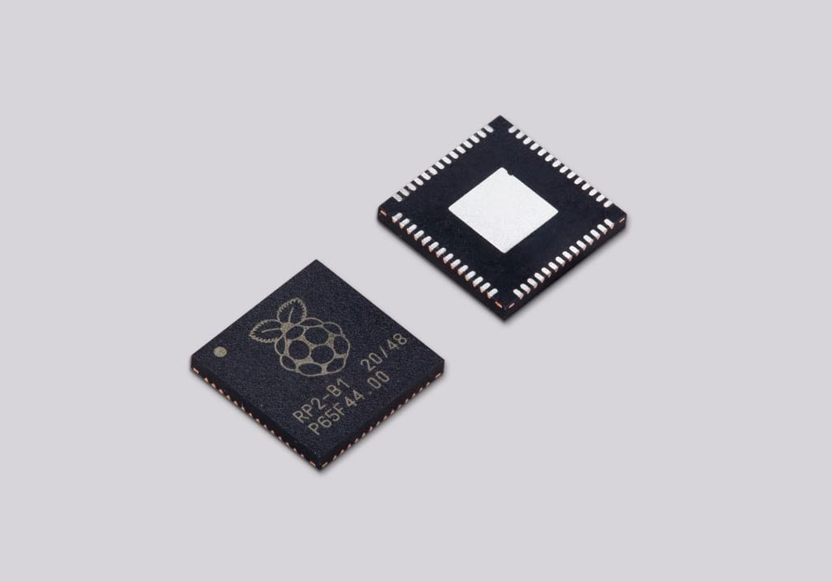
IoT Workshop
NIAEFEUP
Microcontroller
Small computer inside a single IC
May contain one or more CPUs, memory and programmable input and output controllers
Examples are the ATmega328P used in the R1 through R3 Arduino development boards and the RP2040 in the Raspberry Pi Pico
<número>

Slide 16
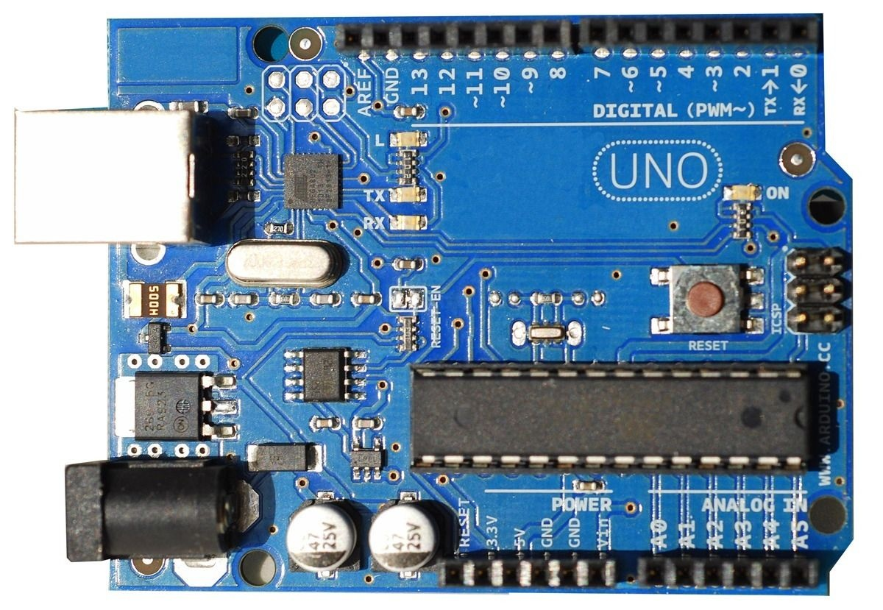
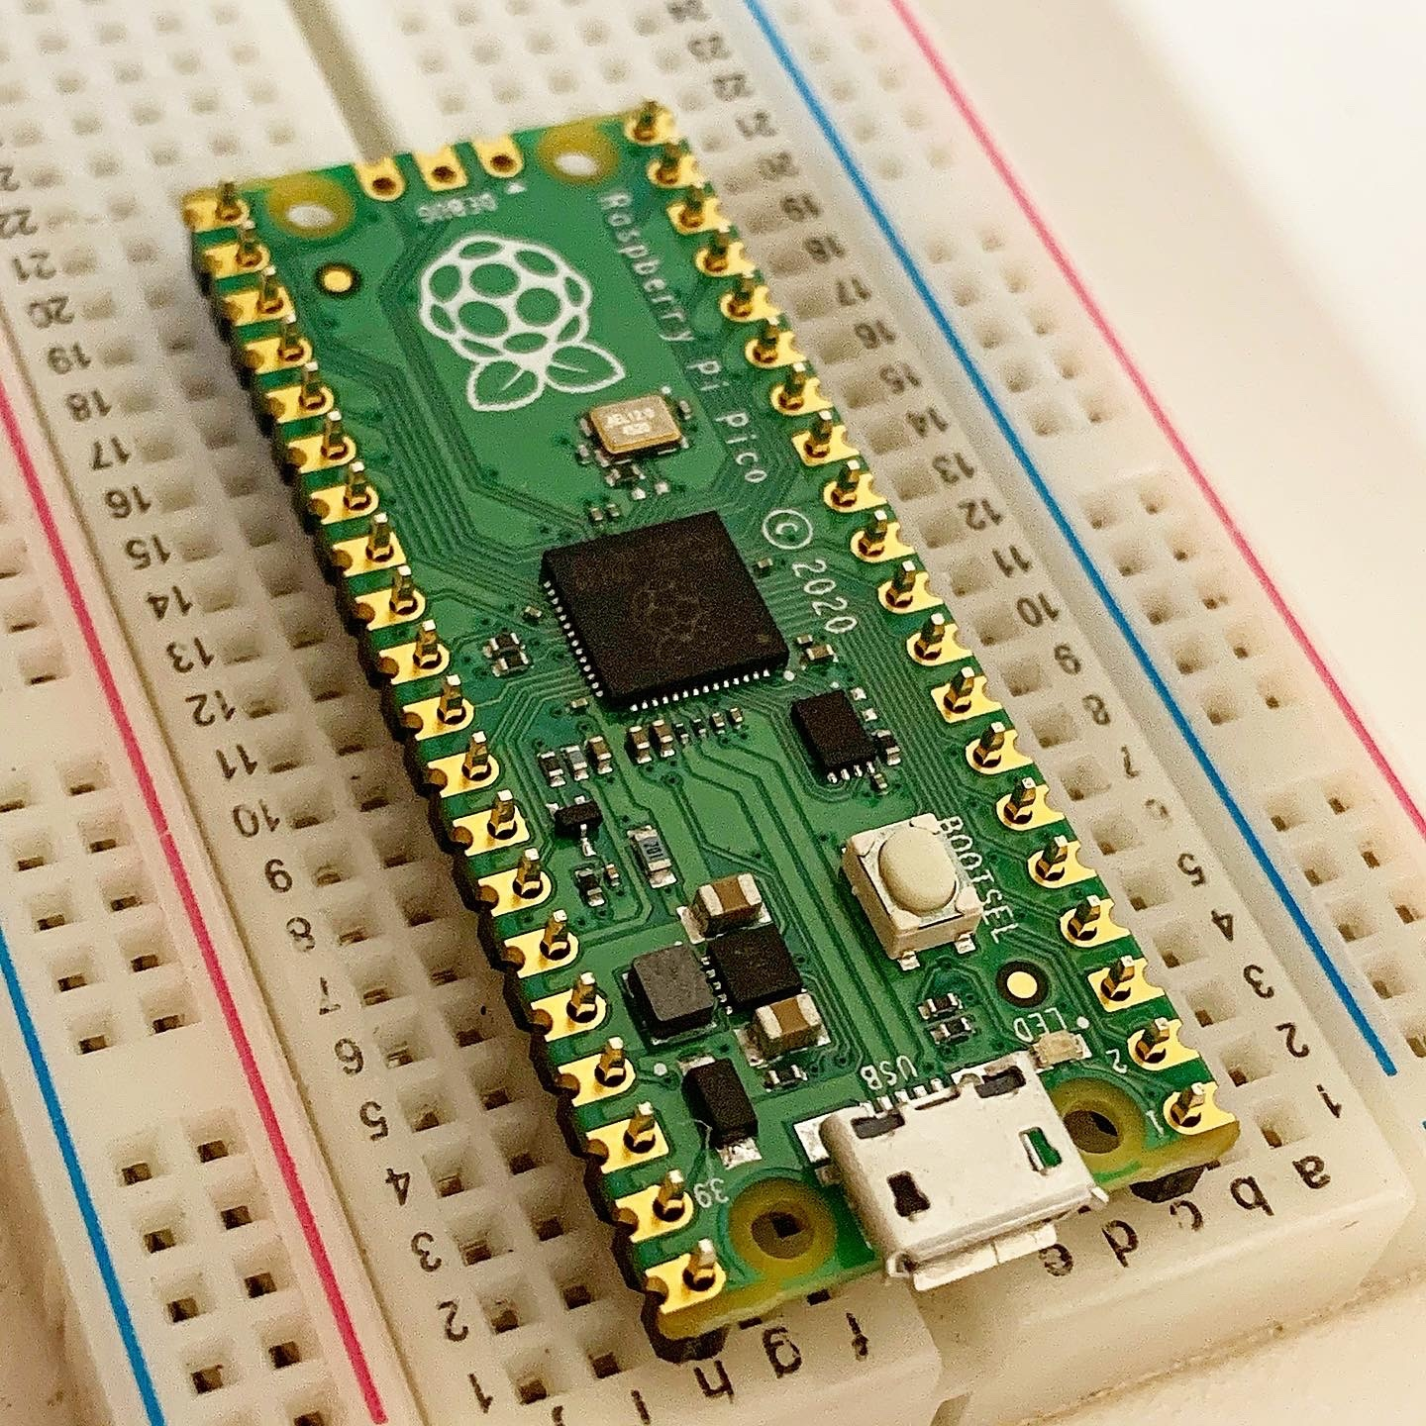
IoT Workshop
NIAEFEUP
Development board
Extend the interfaces available to communicate with microcontrollers
One of those interfaces are the GPIO pins that are used to implement various communication protocols and work using either analogue or digital signals
<número>

Slide 17
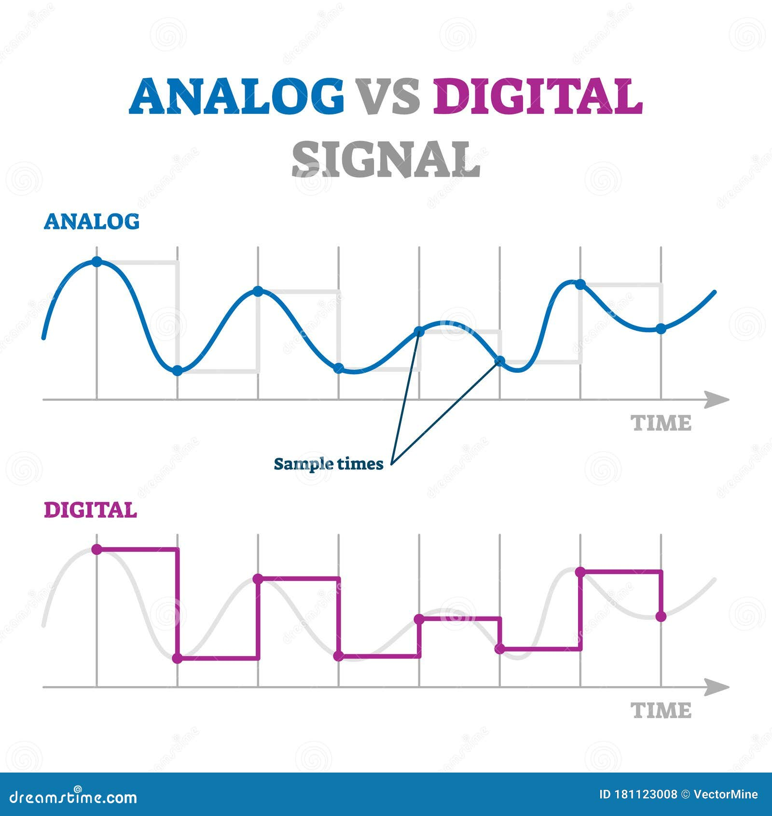
IoT Workshop
NIAEFEUP
Analogue vs Digital
An analogue signal is a continuous signal that uses a time varying feature of that signal to represent some other time varying feature. It is quite error prone, uses a lot of energy and it has poor precision
A digital signal uses discrete values to represent information. It’s more precise, more resilient and consumes less energy
<número>

Slide 18
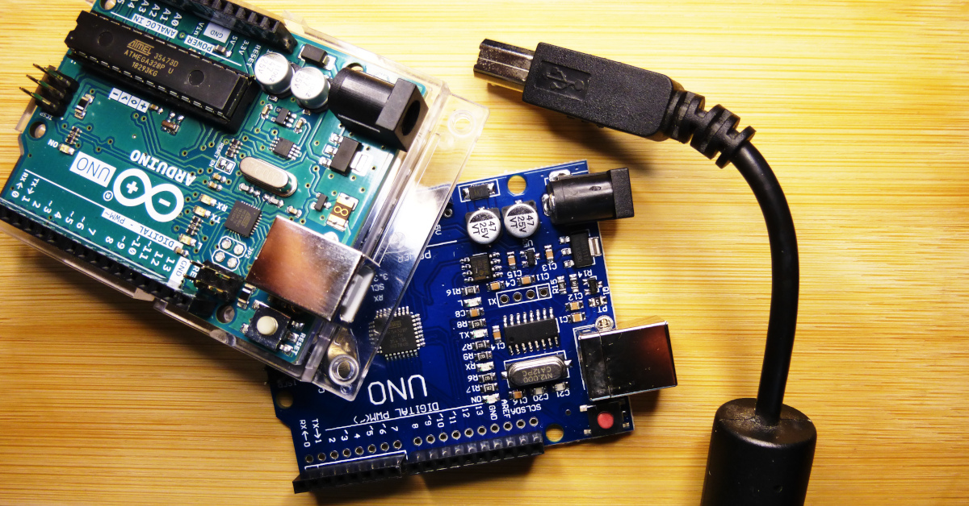
Arduino Framework
3.
<número>

Slide 19
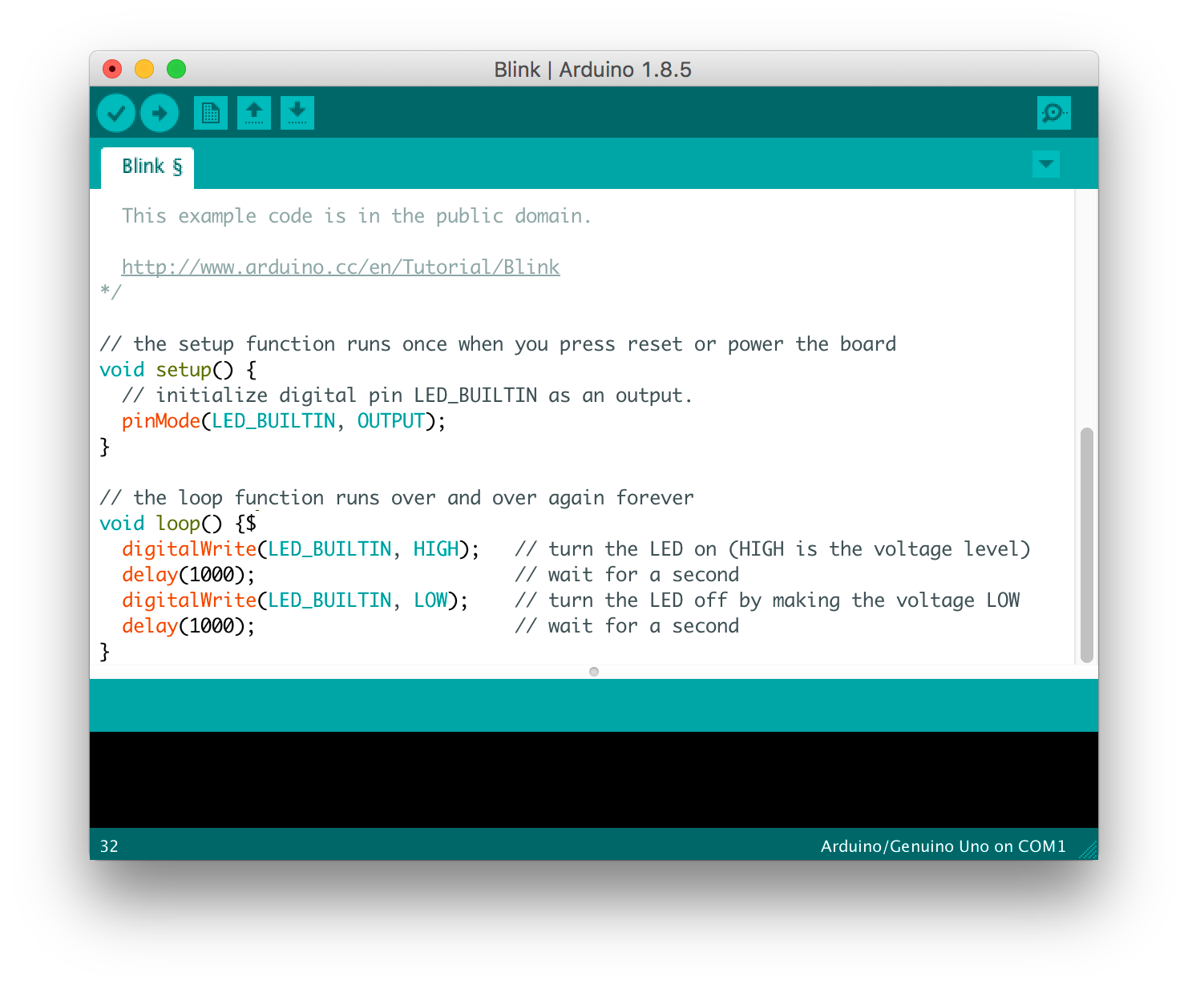
IoT Workshop
NIAEFEUP
Arduino Framework
Has a programming language based on C++
The execution uses 2 functions, the setup() function, used to setup variables, hardware, libraries and pin modes, and the loop() function that loops over the code of that function
Extensive set of libraries implementing support for various peripherals, communication protocols and software libraries
<número>

Slide 20
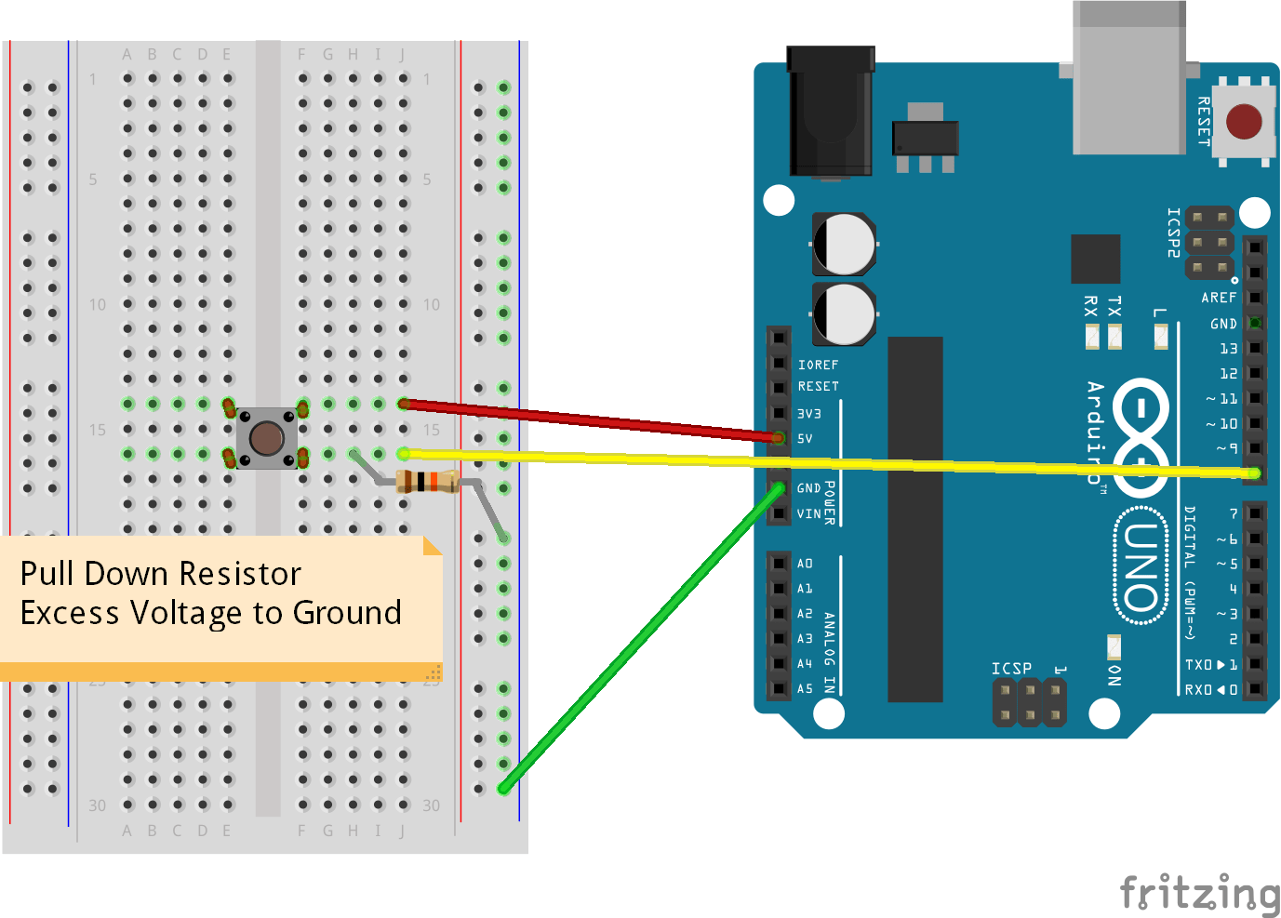
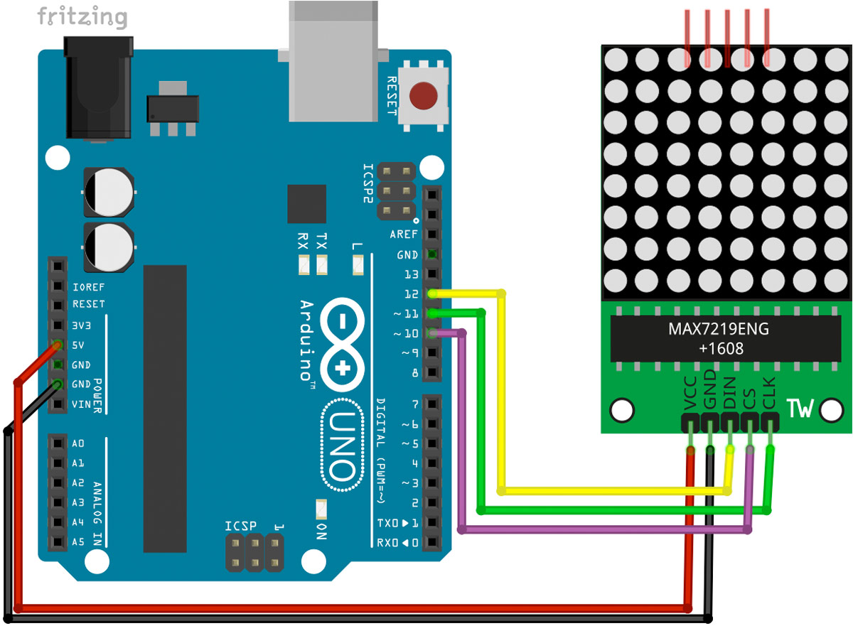
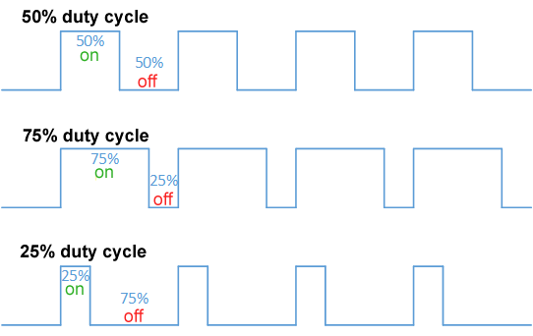
IoT Workshop
NIAEFEUP
Arduino Framework - GPIO
GPIO pins available at the board can be configured to behave as inputs or outputs
By default in the Arduino Framework pins behave as input pins
Usually all input pins can read digital signals but only some can read analog signals
Pins configured as output can only produce square waves (common in digital signals, the pins are either high or low), but similar effects to analog signals can be achieved by turning the signal on and off at the right frequencies (learn about the duty cycle and Pulse Width Modulation - PWM)
Being used as input
Being used as output
<número>

Slide 21
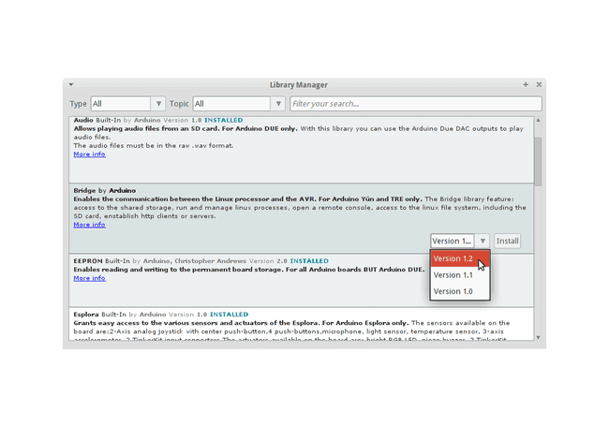
IoT Workshop
NIAEFEUP
Arduino Framework - Libraries
Libraries are managed using the Arduino library manager
Implement communication protocols, support for 3rd party components, software components
<número>

Slide 22
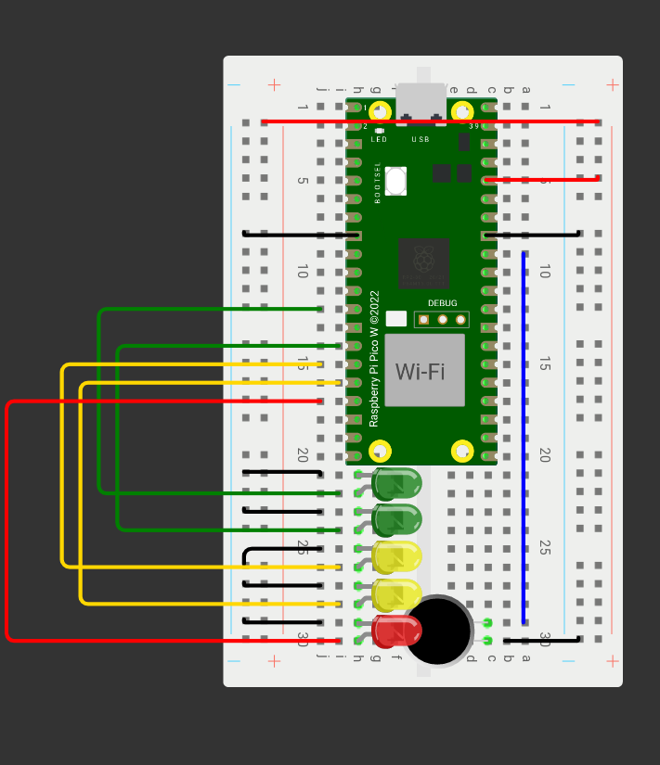
2.
Hands-on
<número>

Slide 23
IoT Workshop
NIAEFEUP
Noise detector
Warn us of excessive noise in the vicinity
Maybe we can stream the noise to our browser
And get an Wireless Microphone!!
<número>

